Slide 1
Azure Stack
Notes:
Information in this document, including URL and other Internet Web site references, is subject to change without notice. Unless otherwise noted, the example companies, organizations, products, domain names, e-mail addresses, logos, people, places, and events depicted herein are fictitious, and no association with any real company, organization, product, domain name, e-mail address, logo, person, place or event is intended or should be inferred. Complying with all applicable copyright laws is the responsibility of the user. Without limiting the rights under copyright, no part of this document may be reproduced, stored in or introduced into a retrieval system, or transmitted in any form or by any means (electronic, mechanical, photocopying, recording, or otherwise), or for any purpose, without the express written permission of Microsoft Corporation.
Microsoft may have patents, patent applications, trademarks, copyrights, or other intellectual property rights covering subject matter in this document. Except as expressly provided in any written license agreement from Microsoft, the furnishing of this document does not give you any license to these patents, trademarks, copyrights, or other intellectual property.
The names of manufacturers, products, or URLs are provided for informational purposes only and Microsoft makes no representations and warranties, either expressed, implied, or statutory, regarding these manufacturers or the use of the products with any Microsoft technologies. The inclusion of a manufacturer or product does not imply endorsement of Microsoft of the manufacturer or product. Links may be provided to third party sites. Such sites are not under the control of Microsoft and Microsoft is not responsible for the contents of any linked site or any link contained in a linked site, or any changes or updates to such sites. Microsoft is not responsible for webcasting or any other form of transmission received from any linked site. Microsoft is providing these links to you only as a convenience, and the inclusion of any link does not imply endorsement of Microsoft of the site or the products contained therein.
© 2018 Microsoft Corporation. All rights reserved.
Microsoft and the trademarks listed at https://www.microsoft.com/en-us/legal/intellectualproperty/Trademarks/Usage/General.aspx are trademarks of the Microsoft group of companies. All other trademarks are property of their respective owners.

Slide 2
Abstract and learning objectives
Abstract
This workshop is designed to teach attendees how to design a hybrid cloud architecture using a combination of the Azure public cloud and Azure Stack. This functional architecture will enable customers to leverage their investments in Azure as a “cloud platform,” rather than Azure as a “place.” Attendees will learn to determine which systems are good candidates for the Azure public cloud and which are better suited on Azure Stack.
After completing this workshop, attendees will be better able to recommend and design hybrid cloud systems that leverage one application and deployment model: Azure.
Learning objectives
Understand when the Azure public cloud versus Azure Stack is appropriate based on customer requirements.
Describe possible integrations between Azure public cloud solutions and Azure Stack
Understand the taxonomy of Azure Stack: tenants, regions, subscriptions, offers, plans, services and quotas.
Describe the resource providers that are available for use with Azure Stack.
Design and deploy hybrid connectivity between Azure public cloud and Azure Stack.

Slide 3
Step 1: Review the customer case study
Outcome
Analyze your customer needs
Timeframe
15 minutes

Slide 4
Customer situation - Contoso Financial
Headquartered in Dallas, TX with a substantial residential mortgage business
Moving to a cloud first model as part of a larger digital transformation
Strong interest in PaaS to increase agility and lower management overhead

Slide 5
Customer situation
“I have seen how applications and infrastructures are deployed and run using Microsoft Azure with both PaaS and IaaS services. These capabilities can transform Contoso with more agility and long-term cost effectiveness”
– Doreen Newton, CTO

Slide 6
Customer situation
One of the primary applications Contoso is interested in modernizing to take advantage of the cloud is their consumer facing mortgage application.
This application is responsible for new applications and consumer access to their current mortgage information.

Slide 7
Customer situation
Current system is hosted in Contoso’s Dallas data center
Virtual Machines hosted in VMWare
Technology stack
Internet Information Server (IIS) for the web tier
Application tiers consist of several custom Windows Services
Microsoft Message Queue (MSMQ) for messaging between tiers
SQL Server 2012 database

Slide 8


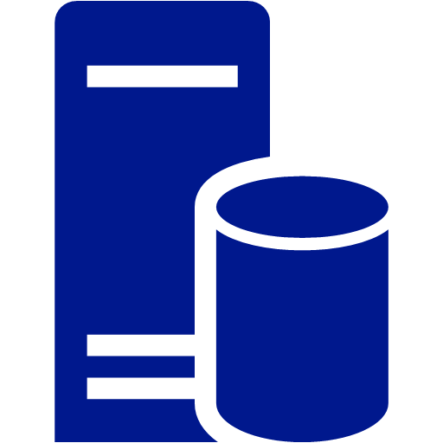



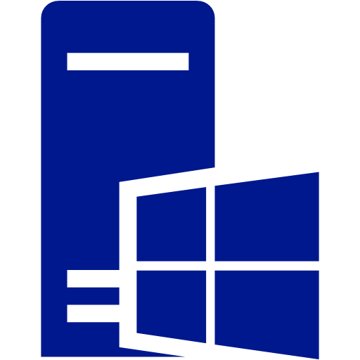

Customer situation
Contoso Data Center (Dallas, TX)

Slide 9
Customer situation - Contoso Financial
During the planning stages, the corporate compliance team determined that customer data cannot reside in the Azure public cloud.
“This was a cause for great concern, as this means Contoso may not be able to move to cloud-based services as fast as we initially envisioned” says Max Rubin VP of Network engineering.
Doreen Newton took on the challenge to investigate alternatives by turning to FusionTumo.

Slide 10
Customer needs
Design a hybrid-cloud architecture that is native Azure end-to-end without the need for hosting the application in a Contoso owned datacenter.
The design should ensure that customer data is not stored in the Azure Cloud while also allowing future applications to be easily deployed in Azure with access to custom data regardless of where they are deployed.
Deploy the Application in a secure manner as to allow for the frontend applications to access the backend customer data.

Slide 11
Customer needs
Establish direct connectivity from the new regional headquarters in Dallas to the deployments. This will allow communication with existing systems and reporting until the rest of Contoso’s services and moved to Azure in the future.
Allow for a consistent application deployment model using Azure ARM Templates and CI/CD.
Detail the Taxonomy that will be leveraged for the hybrid-cloud including the Resource Providers (RP). This includes Tenants, Regions, Subscriptions, Offers, Plans, Services and Quota.

Slide 12
Customer objections
The Mortgage SQL DB cannot be hosted in the public cloud.
Contoso staff is already stretched thin, so minimizing patching of systems and day-to-day management is very important.
The developer team acknowledges that the existing application architecture is designed for running on Windows Virtual Machines, but PaaS is the future they envision. How can they move this application forward?
One of the key reasons Contoso wants to go to the cloud is to take advantage of tools and services for automated deployments and application development. Will Azure Stack make it where we have to use two sets of skillsets?

Slide 13
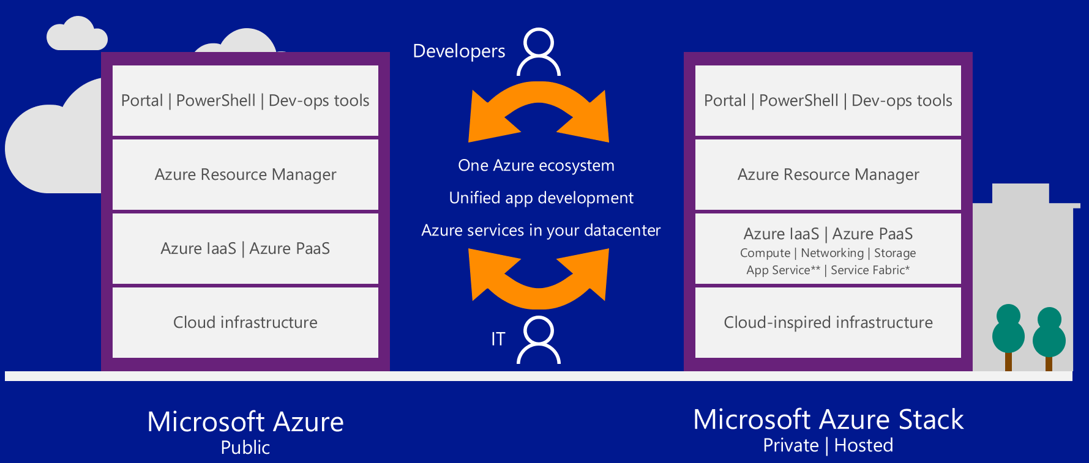
Common scenarios

Slide 14
Step 2: Design the solution
Outcome
Design a solution and prepare to present the solution to the target customer audience in a 15-minute chalk-talk format.
Timeframe
60 minutes
Business needs (10 minutes) | Respond to questions outlined in your guide and list the answers on a flipchart.
Design (35 minutes) | Design a solution for as many of the stated requirements as time allows. Show the solution on a flipchart.
Prepare (15 minutes) | Identify any customer needs that are not addressed with the proposed solution. Identify the benefits of your solution. Determine how you will respond to the customer’s objections. Prepare for a 10-minute presentation to the customer.

Slide 15
Step 3: Present the solution
Outcome
Present a solution to the target customer in a 15-minute chalk-talk format
Timeframe
30 minutes (15 minutes for each team to present and receive feedback)
Directions
Pair with another table
One table is the Microsoft team and the other table is the customer
The Microsoft team presents their proposed solution to the customer
The customer asks one of the objections from the list of objections in the case study
The Microsoft team responds to the objection
The customer team gives feedback to the Microsoft team

Slide 16
Wrap-up
Outcome
Identify the preferred solution for the case study
Identify solutions designed by other teams
Timeframe
15 minutes

Slide 17
Preferred target audience
Doreen Newton, CTO
Max Rubin, VP of Networks
Contoso Teams:
Networking, Security, DevOps and Application Owners
FT Teams
Azure Stack, Networking

Slide 18
Preferred solution: hybrid cloud architecture
Solution overview
Hybrid deployment of Azure Public and Azure Stack
Application components will run in Azure and Azure Stack
Traffic Manager to automatically direct traffic to Azure and Azure Stack
Customer data will reside in Azure Stack

Slide 19
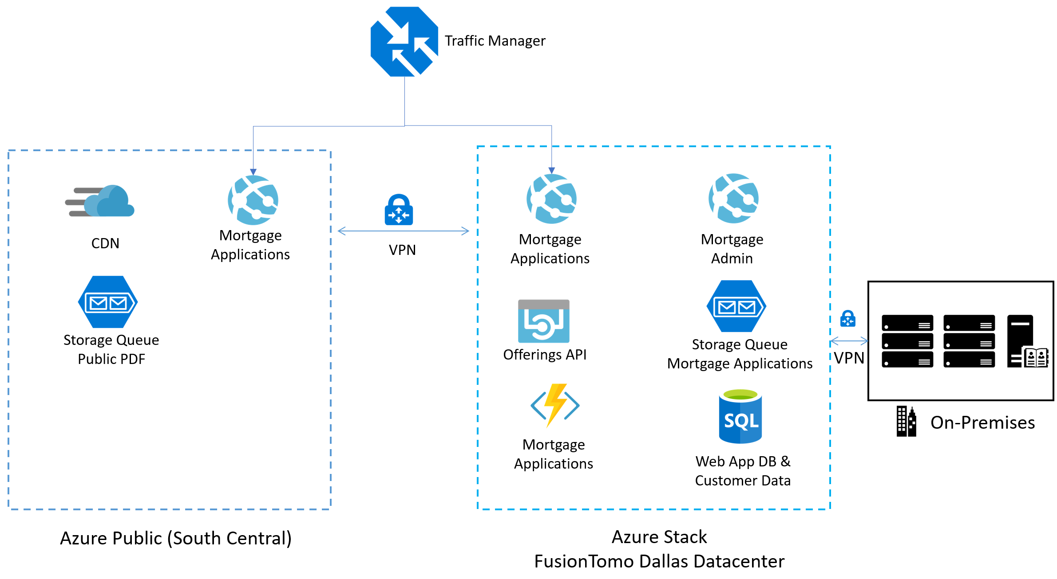
Preferred solution: hybrid cloud architecture

Slide 20
Preferred solution: hybrid-cloud architecture
Azure Stack
Azure Stack SQL Database for the Web App DB and customer data. This will require the Azure Stack SQL DB resource provider to be installed.
Mortgage applications and Mortgage admin: offers API, and function app will be deployed to Azure App services
This will require the Azure Stack Azure app resource provider to be installed.
Azure Blob Storage for secure PDFs
Azure Queue Storage for the Mortgage App messaging

Slide 21
Preferred solution: Azure Stack taxonomy
Cloud operator
FT will act in this role as the Service Provider
Region
One Azure Stack region will be created in the FT Dallas datacenter
Tenant
Contoso Financial will be the sole tenet for US Operations
Can expand to other tenants for other countries/regions
Subscriptions
There will be at least two subscriptions: development and production

Slide 22
Preferred solution: Azure Stack taxonomy
Plans and quotas
FT will create plans to offer the Contoso tenant
Two plans will initially be created: development and production
All services will be allowed for these subscriptions with quotas set lower for development
Offers
Two offers will initially be created: development and production

Slide 23
Preferred solution: Azure Stack taxonomy
Services / resource providers
The base resource providers will be enabled: compute RP, network RP, storage RP and KeyVault RP.
The SQL Server RP will installed and made available.
The Azure App Service RP will installed and made available.
The Windows Server 2016, SQL Server 2017, SQL IaaS Extension for Azure Stack will all be enabled through the Azure Marketplace.

Slide 24
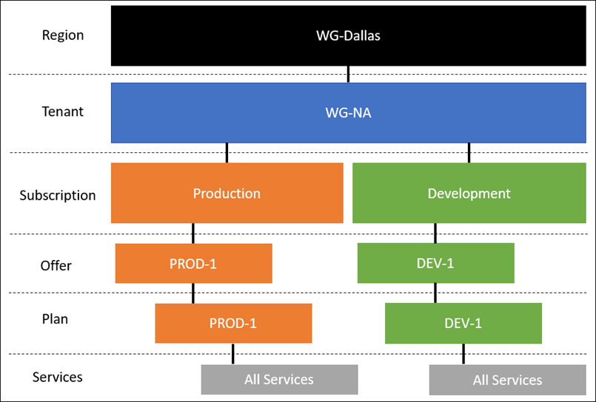
Preferred solution: Azure Stack taxonomy

Slide 25
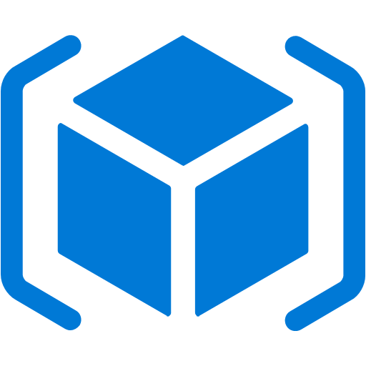

Preferred solution for application deployment
ARM templates
Consistent deployment experience with Azure public cloud and Azure Stack
Hybrid CI/CD pipeline with VSTS
A hybrid continuous integration/continuous delivery(CI/CD) pipeline enables you to build, test, and deploy your app to multiple clouds.
Notes:
Azure Resource Manager templates can be used to deploy supported services to both Azure Public and Azure Stack.
A hybrid continuous integration/continuous delivery(CI/CD) pipeline enables you to build, test, and deploy your app to multiple clouds. A hybrid CI/CD pipeline can help you:
Initiate a new build based on code commits to your Visual Studio Team Services (VSTS) repository.
Automatically deploy your newly built code to Azure for user acceptance testing.
Once your code has passed testing, automatically deploy to Azure Stack.

Slide 26
Preferred solution: networking
The initial proof of concept will start with providing a S2S VPN between the virtual network the Azure Web App is connected to and Azure Stack and another S2S Gateway between the Azure Stack Datacenter in FT and the Contoso Regional HQ.
Notes:
The initial proof of concept will start with providing a S2S VPN between the virtual network the Azure Web App is connected to and Azure Stack and another S2S Gateway between the Azure Stack Datacenter in FT and the Contoso Regional HQ.
For the future, both S2S and ExpressRoute will be configured for routing using BGP ensuring the best connections possible and one set of configurations for routing. FT will provide the Public ASN number for the routes from their datacenter network in Dallas. FT will also configure the BGP connections between their datacenter and the new routers on-premises at the Contoso Dallas office. Contoso’s Public IP Space will be leveraged along with the addition of public IP Space from FT.

Slide 27
Preferred solution: networking
For the future, both S2S and ExpressRoute will be configured for routing using BGP ensuring the best connections possible and one set of configurations for routing. FT will provide the Public ASN number for the routes from their datacenter network in Dallas. FT will also configure the BGP connections between their datacenter and the new routers on-premises at the Contoso Dallas office. Contoso’s public IP space will be leveraged along with the addition of public IP space from FT.

Slide 28
Customer objections handling
The Mortgage SQL DB cannot be hosted in the public cloud.
Potential Answer
The SQL Database which will contain the customer information will be hosted in Azure Stack in the FT datacenter. This will require the SQL DB resource provider to be running on Azure Stack. The data will never reside in the Azure public cloud.

Slide 29
Customer objections
Contoso will have a very limited staff to manage the US based operations, so minimizing patching of systems and day-to-day management is very important.
Potential Answer:
All of the services that are used for this application in both of Azure Public and Azure Stack leverage PaaS. As a result, there is very limited need for management of the platforms beyond the application.

Slide 30
Customer objections
The developer team acknowledges that the existing application architecture is designed for running on Windows Virtual Machines, but PaaS is the future they envision. How can they move this application forward?
Potential Answer
The application code base can be modernized by converting the Windows Services to Azure Functions, messaging based code could use Azure Storage Queues or Service Bus, and code that reads and writes from the file system could be updated to use Azure Storage. Finally, application code that writes to SQL Server could be updated to use SQL Database.

Slide 31
Customer objections
One of the key reasons Contoso wants to go to the cloud is to take advantage of tools and services for automated deployments and application development. Will Azure Stack make it to where we must use two skillsets?
Potential Answer
While there will be minor differences with connectivity/environment information, as long as the resources are supported in both clouds the developer and tooling experience will be consistent.

Slide 32
Customer quote
Our plans to enter the North American Mortgage market were enabled by our Partner, FusionTomo helping us to leverage our investment in Azure as a platform with Azure Stack. We can move forward with our project timelines.
- Regional IT Leader, Doreen Newton

